Slide 1
Kappa: A Programming Framework for Serverless Computing
Zhang, Wen, et al.
Proceedings of the 11th ACM Symposium on Cloud Computing. 2020.
Cloud Computing
220908 Sohee Kim
Notes:
https://dl.acm.org/doi/pdf/10.1145/3419111.3421277

Slide 2
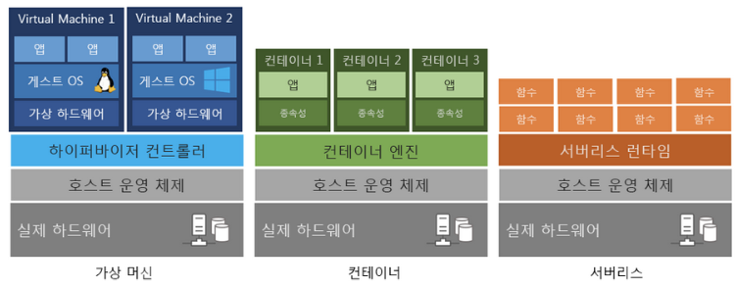
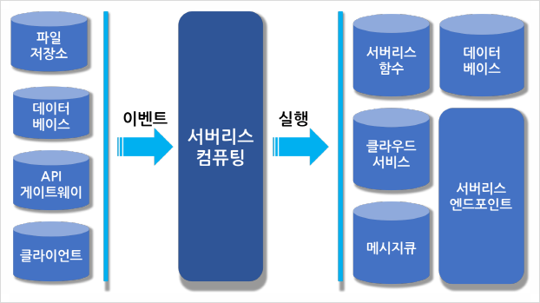
1. Introduction
Zhang, Wen, et al. "Kappa: A programming framework for serverless computing." Proceedings of the 11th ACM Symposium on Cloud Computing. 2020.
Serverless computing
New cloud paradigm (instead provisioning VMs)
Tenants – register event handlers (Python functions) with platform
Platform invokes the handler on a lambda function, a short-lived, stateless execution environment
Greater elasticity
Providers
Periodically terminate jobs running on lambda functions -> improving datacenter utilization
Two main challenges
Programmers must manually partition their computation to fit within the lambda function time limit
Programmers have no concurrency or synchronization primitives at their disposal, and so must either implement such primitives, restrict themselves to use share-nothing parallelism, or eschew the use of parallel lambdas
https://buildgoodhabit.tistory.com/73
Notes:
Serverless computing is a new cloud paradigm where, instead of provisioning virtual machines (VMs), tenants register event handlers (e.g., Python functions) with the platform. When an event occurs, the platform invokes the handler on a lambda function, a short-lived, stateless execution environment. A lambda function can execute for a bounded duration (e.g., 15 min on AWS) before being terminated.
Serverless computing benefits both cloud tenants and providers. Tenants no longer need to provision or scale their VMs, and enjoy greater elasticity from fast lambda boot times. Providers can periodically terminate jobs running on lambda functions ,improving datacenter utilization.
Despite this interest on serverless computing, it remains difficult due to two main challenges: (1) programmers must manually partition their computation to fit within the lambda function time limit; and (2) programmers have no concurrency or synchronization primitives at their disposal, and so must either implement such primitives, restrict themselves to use share-nothing parallelism, or eschew the use of parallel lambdas.

Slide 3
1. Introduction
Zhang, Wen, et al. "Kappa: A programming framework for serverless computing." Proceedings of the 11th ACM Symposium on Cloud Computing. 2020.
Kappa : A programming framework for general-purpose, parallel serverless applications
Checkpointing
To run long tasks on time-bounded lambdas, Kappa checkpoints program state periodically and restores from this checkpoint upon lambda function timeout.
Continuation-based checkpointing mechanism – operates in user mode and requires no modifications to the serverless platform.
Concurrency API
To program parallel lambdas, Kappa provides a concurrency API that supports spawning tasks, waiting on futures, and passing messages between lambdas.
Fault tolerance
Kappa tasks can exhibit nondeterminism and side effects. Using checkpoints, Kappa ensures that execution never diverges due to nondeterminism, and that any side effects invoked within the system are never re-executed in face of arbitrary lambda function timeouts.
Notes:
This paper presents Kappa, a programming framework for general-purpose, parallel severless applications
Kappa offers three main features:
1. Checkpointing. To run long tasks on time-bounded lambdas, Kappa checkpoints program state periodically and restores from this checkpoint upon lambda function timeout. Our continuation-based checkpointing mechanism (§ 3.2) operates in user mode and requires no modifications to the serverless platform.
2. Concurrency API. To program parallel lambdas, Kappa provides a concurrency API that supports spawning tasks, waiting on futures, and passing messages between lambdas (§ 3.3).
3. Fault tolerance. Kappa tasks can exhibit nondeterminism and side effects. Using checkpoints, Kappa ensures that execution never diverges due to nondeterminism, and that any side effects invoked within the system are never re-executed in face of arbitrary lambda function timeouts (§ 3.1).
Kappa requires no changes to the platform, thus allowing general applications to run on existing serverless offerings
Producing such framework is the main contribution of this work.

Slide 4
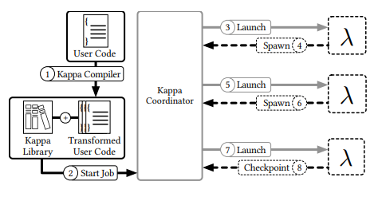
2. Kappa Design
Zhang, Wen, et al. "Kappa: A programming framework for serverless computing." Proceedings of the 11th ACM Symposium on Cloud Computing. 2020.
Kappa workflow
Coordinator – launching, resuming tasks / implementing Kappa’s concurrency primitives
Compiler – generating code required for checkpointing
Library – used by tasks for checkpointing, concurrent processing, synchronization
Coordinator actions
RPCs
Task = logical thread of execution running
Runs on one or more lambda functions
Notes:
Kappa executes parallel code of arbitrary duration using short-lived lambda functions.
In Kappa, a task represents a logical thread of execution running in its own memory space, and physically runs on one or more lambda functions.
We allow tasks to span multiple lambda functions by periodically checkpointing them. When a lambda function executing a task dies, the task is resumed on another lambda function by restoring the checkpoint. While tasks are single-threaded, Kappa enables concurrent processing by allowing each task to spawn other tasks which execute in parallel, and by providing inter-task communication mechanisms that allow tasks to communicate and coordinate with each other.
Kappa has three components: (1) a coordinator responsible for launching and resuming tasks (§ 3.1) and for implementing Kappa’s concurrency primitives (§ 3.3); (2) a compiler responsible for generating code required for checkpointing (§ 3.2); and (3) a library used by tasks for checkpointing, concurrent processing, and synchronization.
As shown in Figure, when using Kappa, a programmer writes code similar to what runs on a traditional platform, with minor modifications required by Kappa (§ 6). Next, the compiler transforms this code into a form suitable for use by Kappa. Lastly, this program is packaged with the Kappa library and launched by the coordinator, which starts by running a designated “main” task.

Slide 5
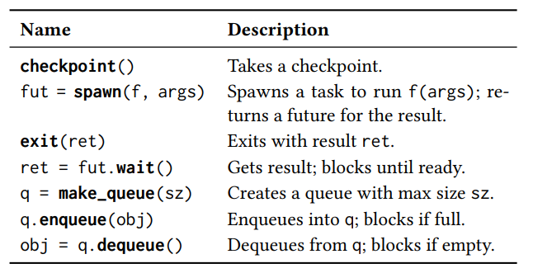
2. Kappa Design
Zhang, Wen, et al. "Kappa: A programming framework for serverless computing." Proceedings of the 11th ACM Symposium on Cloud Computing. 2020.
Coordinator
The Kappa coordinator is responsible for
Scheduling tasks on lambda functions
Implementing synchronization and cross-task communication
Tracking task metadata (including checkpoints)
Providing fault tolerance
Coordinator actions
The coordinator tracks the latest checkpoint of each task.
A task writes checkpoint content directly to storage, and the coordinator maintains only checkpoint locations.
Tasks communicate with the coordinator through the remote procedure calls (RPCs)
RPCs
Core coordinator RPCs
Update checkpoint ID
Task t timed out or failed -> restarts t from its latest checkpoint on a new lambda function
Notes:
Next is about Coordinator
The Kappa coordinator is responsible for scheduling tasks on lambda functions, implementing synchronization and cross-task communication, tracking task metadata (including checkpoints), and providing fault tolerance.
We merely require that the lambda functions be able to initiate network connections to the coordinator, and that the coordinator be able to access the same storage services (e.g., S3) as lambda functions
The coordinator tracks the latest checkpoint of each task. A task writes checkpoint content directly to storage (e.g., S3 or Redis), and the coordinator maintains only checkpoint locations. Tasks communicate with the coordinator through the remote procedure calls (RPCs) summarized in this Table.
For instance, after writing a checkpoint, a task uses the checkpoint RPC to update its checkpoint ID with the coordinator.
When a lambda running task 𝑡 has timed out or failed, the coordinator restarts task 𝑡 from its latest checkpoint on a new lambda function. Tasks may lose some progress and re-execute some code as a result of being restarted.

Slide 6
2. Kappa Design
Zhang, Wen, et al. "Kappa: A programming framework for serverless computing." Proceedings of the 11th ACM Symposium on Cloud Computing. 2020.
Coordinator
Code re-execution can be problematic
Assume – all effectful calls are processed through coordinator
Ensure – coordinator RPCs are executed once / never executed (times out)
Coordinator actions
Fault tolerance of the coordinator itself
Kappa provides the option to continuously replicate coordinator state to a backing store.
Processes an RPC / lambda function timeout => it sends a state update to the backing store and waits for it to be persisted
Supports checkpoint replications to tolerate storage node failures
RPCs
Core coordinator RPCs
Notes:
Code re-execution can be problematic when making calls with side effects.
In Kappa, they assume that all effectful calls are processed through the coordinator, and ensure that coordinator RPCs are executed once or are never executed, the latter being possible when the task times out (or fails) before successfully contacting the coordinator.
We implement this guarantee by requiring the task making an RPC to also take a checkpoint that resumes execution after the RPC. The coordinator points the task’s metadata to this checkpoint as it executes the RPC, so that it can resume a failed task from the point where the RPC returns. Compared to relying on user-provided unique IDs or runtime-generated sequential IDs, our mechanism requires neither user intervention nor special handling for nondeterministic code. The Kappa library invokes this mechanism automatically for RPCs.
For fault tolerance of the coordinator itself, Kappa provides the option to continuously replicate coordinator state to a backing store. With this option enabled, every time the coordinator processes an RPC or a lambda function timeout, it sends a state update to the backing store and waits for it to be persisted. After a failure, the coordinator can reconstruct its previous state from the store and resume the workload. Kappa also supports checkpoint replication to tolerate storage node failures (§ 4). Our evaluations (§ 5) demonstrate low overhead even with both coordinator state and checkpoint replication. If needed, the overhead can be further reduced by having the coordinator send batch updates periodically

Slide 7
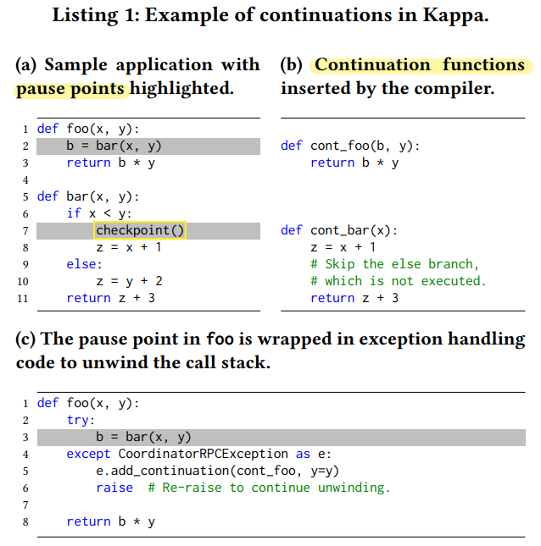
2. Kappa Design
Zhang, Wen, et al. "Kappa: A programming framework for serverless computing." Proceedings of the 11th ACM Symposium on Cloud Computing. 2020.
Checkpointing
Example of continuations
Checkpoints – implemented using continuations
A well understood technique for suspending and resuming execution
A closure that captures program state and control flow information at some execution point
Pause points
Takes a checkpoint by generating a continuation and serializing it to storage
Restores from a checkpoint by deserializing and invoking a previously stored continuation
Checkpoint (list)
Function name
Live variables
Hole
- Previous continuation’s result
Notes:
As mentioned before, Kappa uses checkpoints to tolerate lambda function timeouts and to prevent RPC duplication.
Checkpoints in Kappa are implemented using continuations [74], a language-level mechanism executed in user mode. Continuations are a well understood technique for suspending and resuming execution, and have been used in past systems for checkpointing and fault tolerance [79, 88], task migration [28, 78, 79, 88], asynchronous calls [51, 54], context switching [86], and debugging [16]. Kappa’s checkpointing technique is nearly identical to that of previous systems, although there might be implementation differences.
A continuation can be thought of as a closure that captures program state and control flow information at some execution point; calling the closure resumes execution from this point in the program.
Kappa takes a checkpoint by generating a continuation and serializing it to storage, and restores from a checkpoint by deserializing and invoking a previously stored continuation.
This list is an example of continuations. I will explain how continuations are generated for the checkpoint() call on line 7. The code is first transformed by the Kappa compiler, which identifies all the pause points in the code, which is highlighted. There are 2 pause points.
For each, the compiler generates a continuation function definition and inserts it into the source code.
As shown in B, a continuation function contains all the code that executes after the corresponding pause point, and takes a arguments any variable whose value is accessed by the subsequent code (called live variables)
Finally, consider the function call foo(3,4) at execution time. The checkpoint taken by bar can be written as a list consisting of one continuation per frame on the call stack: [(cont_bar, x = 3), (cont_foo, b = □, y = 4)] ,
where a continuation is a tuple of (1) its continuation function’s name and (2) live variables in that frame; “□” denotes a hole to be filled in with the previous continuation’s result.
To resume from this checkpoint, the Kappa library invokes the continuations in order (e.g., cont_bar(x=3)), substituting each continuation’s return value into its successor’s hole. The return value of the topmost function—i.e., the task’s final result—is reported to the coordinator.

Slide 8
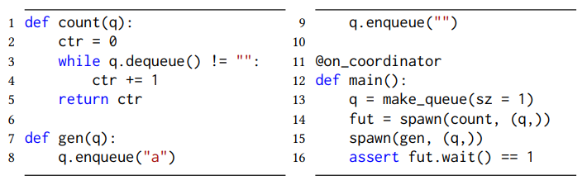
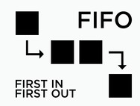
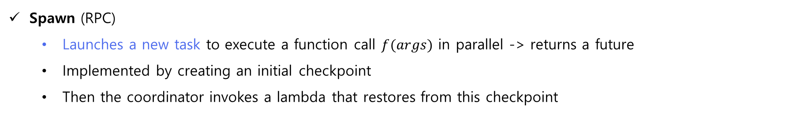
2. Kappa Design
Zhang, Wen, et al. "Kappa: A programming framework for serverless computing." Proceedings of the 11th ACM Symposium on Cloud Computing. 2020.
Concurrency API
Sample concurrent Kappa program
Mechanisms for launching and synchronizing parallel tasks – exploit the resource elasticity
Decorator
Spawn (RPC)
Launches a new task to execute a function call $f(args)$ in parallel -> returns a future
Implemented by creating an initial checkpoint
Then the coordinator invokes a lambda that restores from this checkpoint
FIFO queues
Kappa tasks can communicate using multi-producer multi-consumer FIFO queues
Have bounded size - a task blocks when it enqueues to a full queue or dequeues from an empty queue
These semantics allow queues to be used not only for inter-process communication but also as locks and semaphores
Notes:
Next is about concurrency API.
Kappa provides mechanisms for launching and synchronizing parallel tasks, making it easier to exploit the resource elasticity offered by serverless platforms.
Specifically, they provide two basic concurrency abstractions:
The spawn RPC launches a new task to execute a function call f(args) in parallel and returns a future [50] for the result.
A spawn is implemented by creating an initial checkpoint that, when resumed, executes the function call; the coordinator then invokes a lambda that restores from this checkpoint.
Kappa tasks can communicate using multiproducer multi-consumer FIFO queues. These queues have bounded size—a task blocks when it enqueues to a full queue or dequeues from an empty queue. These semantics allow queues to be used not only for inter-process communication but also as locks and semaphores
Right one illustrates the use of these primitives.
The entry point function main is marked with the on_coordinator decorator, indicating that it runs as a process on the coordinator rather than on a lambda function.

Slide 9
2. Kappa Design
Zhang, Wen, et al. "Kappa: A programming framework for serverless computing." Proceedings of the 11th ACM Symposium on Cloud Computing. 2020.
External Services
A Kappa task can call services external to the platform
Two fault tolerance challenges -> ensure that
External calls with side effects be issued only once even when lambdas time out
Calls that last longer than the lambda time limit make progress
Kappa solves both challenges in an extensible manner using spawn : the programmer wraps a stateful external call in a child task, spawns it on the coordinator, and waits for it to finish
The RPC mechanism ensures that the spawn, and thus the external service call, is never duplicated
Kappa can run several on-coordinator tasks in parallel
External storage services are treated specially
Writing to storage is effectful and thus must happen on the coordinator.
To avoid routing all write content through the coordinator, Kappa provides a helper that first writes the content to a temporary location in storage, and then issues a coordinator RPC that moves the temporary file to its intended location.
Notes:
Last is about Externel Services.
A Kappa task can call services external to the platform (e.g., a REST API for computer vision).
Interactions with external services pose two fault tolerance challenges: Kappa must ensure that (1) external calls with side effects be issued only once even when lambdas time out;8 and (2) calls that last longer than the lambda time limit make progress.
Kappa solves both challenges in an extensible manner using spawn: the programmer wraps a stateful external call in a child task, spawns it on the coordinator (§ 3.3), and waits for it to finish. The RPC mechanism (§ 3.1) ensures that the spawn, and thus the external service call, is never duplicated.
Note that since the coordinator is not executed on a lambda function, Kappa can run several on-coordinator tasks in parallel.
External storage services are treated specially. Writing to storage is effectful and thus must happen on the coordinator (except for tasks idempotent with respect to storage). To avoid routing all write content through the coordinator, Kappa provides a helper that first writes the content to a temporary location in storage, and then issues a coordinator RPC that moves the temporary file to its intended location.

Slide 10
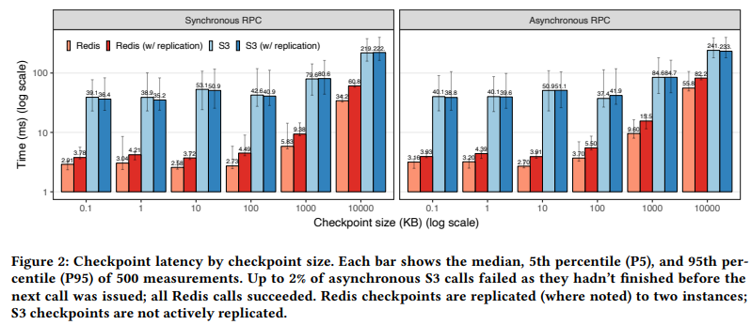
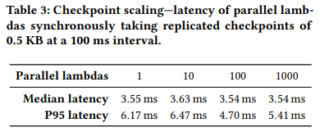
3. Evaluation
Zhang, Wen, et al. "Kappa: A programming framework for serverless computing." Proceedings of the 11th ACM Symposium on Cloud Computing. 2020.
Checkpointing Overhead
Synchronous / Asynchronous checkpoints
Time : S3 > Redis
Asynchronous : slower
~100KB : Synchronous latency = 5ms↓
< 4ms
Notes:
Next, they demonstrate the performance and generality of Kappa.
For checkpointing Overhead,
They run a task on a lambda function that checkpoints every 100 millisecond and measure the latency. They look at both synchronous checkpoints (where application processing is paused until the checkpoint is persisted and the RPC returns) and asynchronous checkpoints (where a background step persists the checkpoint and makes the RPC)
Figure 2 shows the checkpoint latency for various sizes. Redis outperforms S3 for all sizes although the gap narrows for larger sizes, where throughput dominates.
Replication overhead is less than 2 ms for Redis checkpoints of up to 100 KB, / but grows more rapidly afterwards as replication becomes throughput-bound.
Finally, asynchronous checkpointing is slower as it is overlapped with foreground computation.
Overall, the median synchronous checkpoint latency is under 5 ms (with replication) for checkpoints up to 100 KB, which is not expected to significantly impact application performance
Finally, we evaluate the scalability of checkpointing by measuring the latency of concurrent lambdas simultaneously taking 0.5 KB checkpoints (with replication) at a 100 ms interval. Table 3 shows that the median checkpoint latency remains less than 4 ms even with 1000 concurrent lambdas. We can achieve good scaling for larger checkpoint sizes as well by scaling up the Redis store (since the coordinator load is unaffected by checkpoint size).

Slide 11
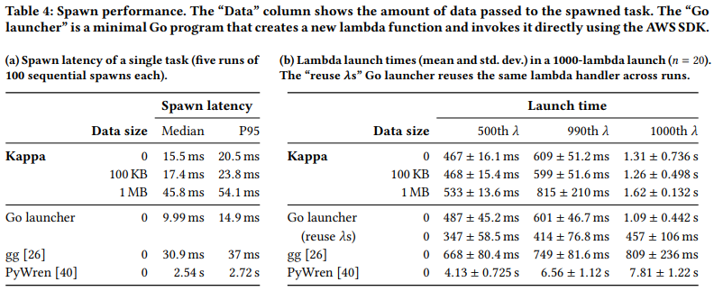
3. Evaluation
Zhang, Wen, et al. "Kappa: A programming framework for serverless computing." Proceedings of the 11th ACM Symposium on Cloud Computing. 2020.
Performance of Kappa Library
<55ms
Spawn latency
Spawn throughput
Overhead includes one-time setup costs since parallel lambdas cannot recycle execution environments
Notes:
For evaluation of performance of Kappa Library,
They have an on-coordinator task measure the latency of spawning an empty task and waiting for its completion, varying the amount of data passed to the task.
As left Table shows, even when passing a large 1 MB argument, Kappa launches a task within 55 ms over 95 % of the time.
Right Table shows the mean launch times for the 500th, 990th, and 1000th lambdas
For up to 990 tasks, Kappa adds a roughly 10 ms overhead over the Go launcher without lambda reuse.
Unlike in single-spawn, this overhead includes one-time setup costs since parallel lambdas cannot recycle execution environments

Slide 12
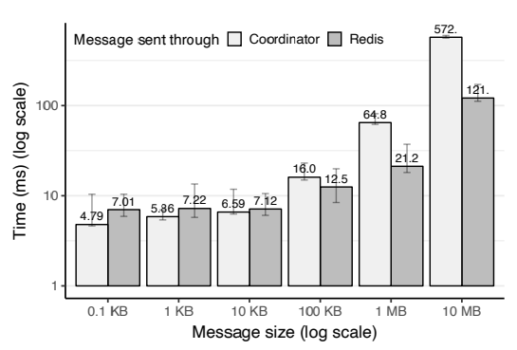
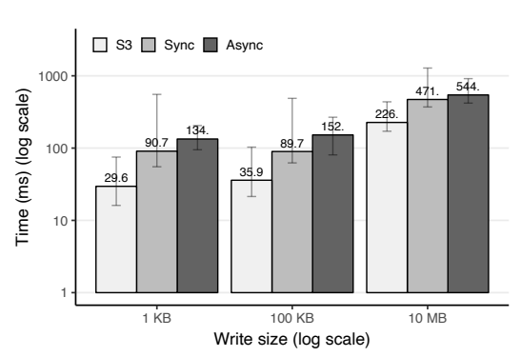
3. Evaluation
Zhang, Wen, et al. "Kappa: A programming framework for serverless computing." Proceedings of the 11th ACM Symposium on Cloud Computing. 2020.
Performance of Kappa Library
Message passing
Fault-tolerant writes
Latency of message passing between tasks
Latency of fault-tolerant vs raw S3 writes
Coordinator - faster for small messages, slower for large messages
Fault-tolerant writes to be costly
Notes:
Left Figure shows message passing latency for various configurations.
Passing messages through the coordinator is faster for small messages (tens of KB) since it saves a round-trip to Redis, but is slower for larger messages due to RPC processing overhead.
For fault-tolerant S3 writes (§ 3.4), we measure the duration from when the write is issued /to when the object is moved to its intended location
Right Figure shows fault-tolerant writes to be costly (2.08×–3.06× median overhead for synchronous writes), because we had to implement S3 moves using a slow COPY-DELETE sequence. Applications idempotent with respect to storage can avoid this overhead by writing to storage directly

Slide 13
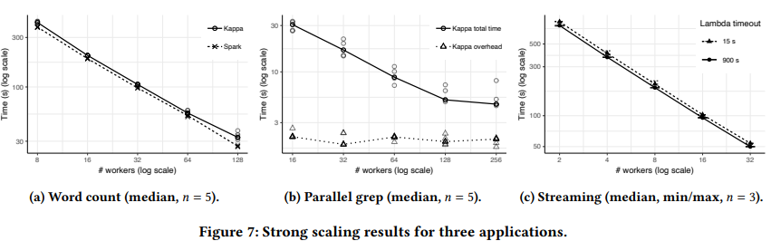
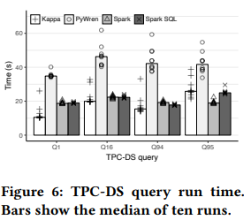
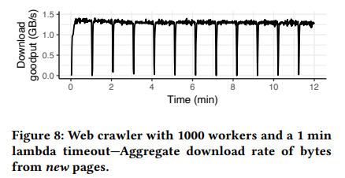
4. Applications
Zhang, Wen, et al. "Kappa: A programming framework for serverless computing." Proceedings of the 11th ACM Symposium on Cloud Computing. 2020.
5 Kappa applications
TPC-DS
Word count
Parallel grep
Streaming
Web crawler
Notes:
They presented five Kappa applications to demonstrate the generality and performance of the framework.

Slide 14
5. Limitations, Conclusion
Zhang, Wen, et al. "Kappa: A programming framework for serverless computing." Proceedings of the 11th ACM Symposium on Cloud Computing. 2020.
Limitations
Unsupported Python features
not yet added support for some Python features (try/except, yield, async/await, nested function definitions, global variables) to the compiler’s continuation generation logic
Other restrictions on input code
The programmer must: Insert checkpoint(), Mark calls that have externally visible side-effects with @on_coordinator, Use Kappa’s concurrency primitive instead of primitives such as Python threads
Static pause points
Restricts where checkpoints can be generated and precludes deciding checkpoint locations at runtime
Can only checkpoint in transformed code
Checkpoint only in code transformed by the its compiler and not in a Python C extension like numpy
Kappa is a framework that simplifies serverless development by providing a familiar programming model.
By reducing the friction of developing serverless programs, Kappa provides an avenue for a larger set of applications to take advantage of the benefits of serverless computing.
Notes:
While Kappa already supports a wide range of applications, it has a few limitations :
First, They have not yet added support for some Python features to the compiler’s continuation generation logic
Beyond the aforementioned restrictions on Python features, Kappa requires minor modifications to application code.
The programmer must: Insert checkpoint() calls at appropriate points in the program, Mark calls that have externally visible side-effects (e.g., resulting in I/O) with @on_coordinator, and Use Kappa’s concurrency primitives (§ 3.3) instead of primitives such as Python threads.
Kappa identifies pause points statically, and this approach reduces the runtime overhead of checkpointing, but restricts where checkpoints can be generated and precludes deciding checkpoint locations at runtime. Relaxing this limitation through dynamic continuation computation is left to future work.
Kappa can checkpoint only in code transformed by the its compiler and not in, e.g., a Python C extension like numpy.
Python’s dynamic nature makes it challenging to statically analyze application code
Although serverless computing originally targeted event handling, recent efforts such as ExCamera [27] and PyWren [40] have enabled the use of serverless for more diverse applications. However, developing serverless applications still requires significant effort. Kappa is a framework that simplifies serverless development by providing a familiar programming model. By reducing the friction of developing serverless programs, Kappa provides an avenue for a larger set of applications to take advantage of the benefits of serverless computing.

Slide 15
Thank You ☺

